Slide 1

LAB MEETING
바이오메디컬공학부
201715447
김준형

Slide 2
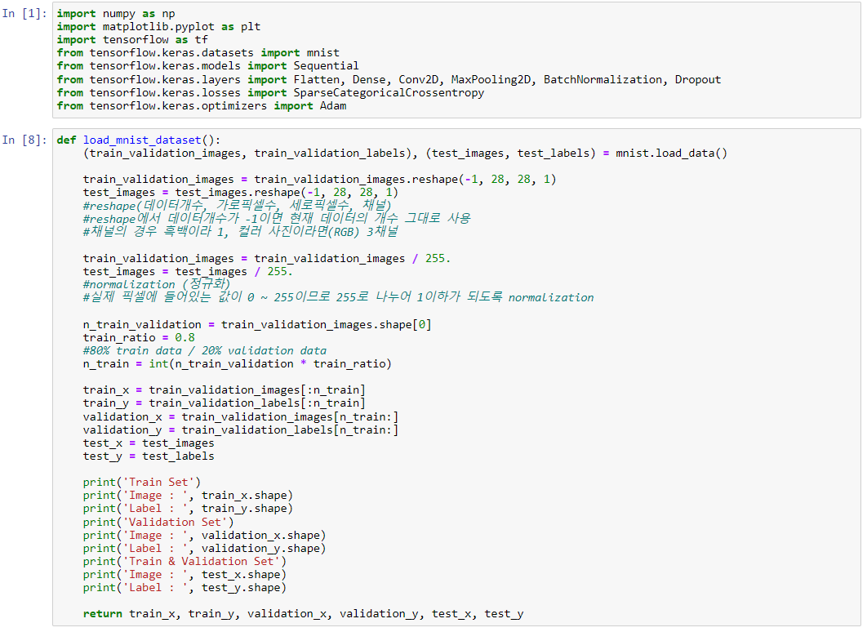
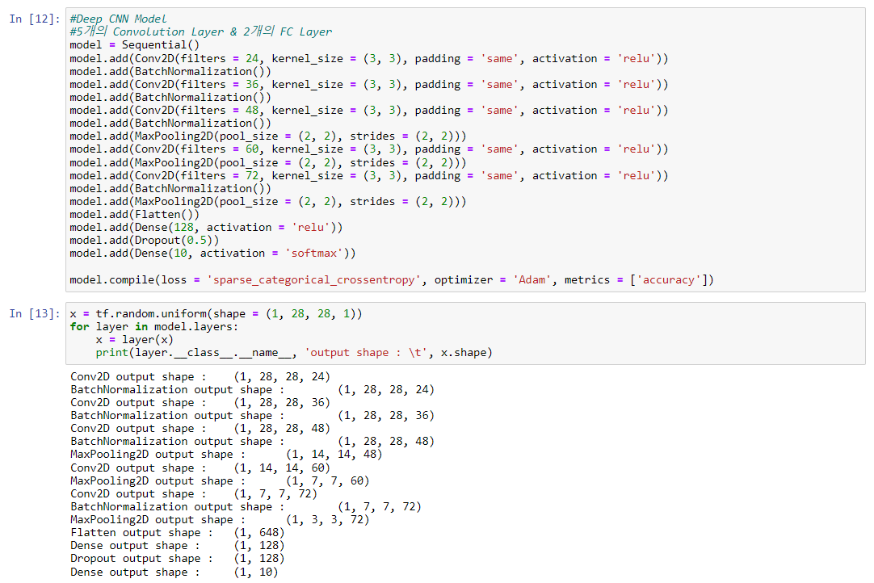
● 1. Deep CNN with Tensorflow & Keras

Slide 3
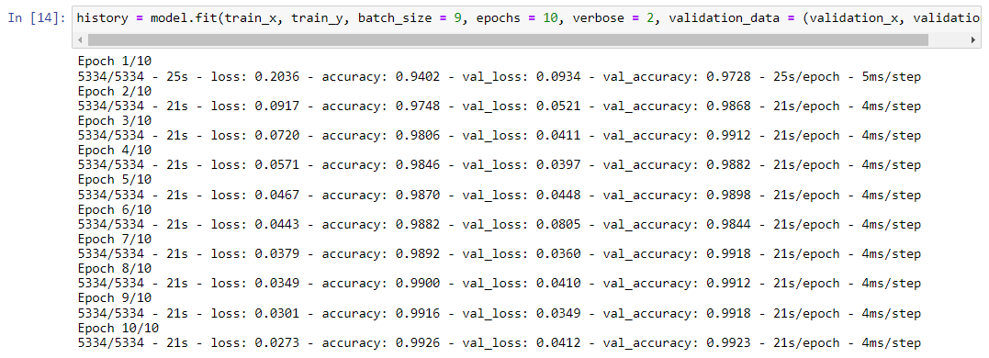
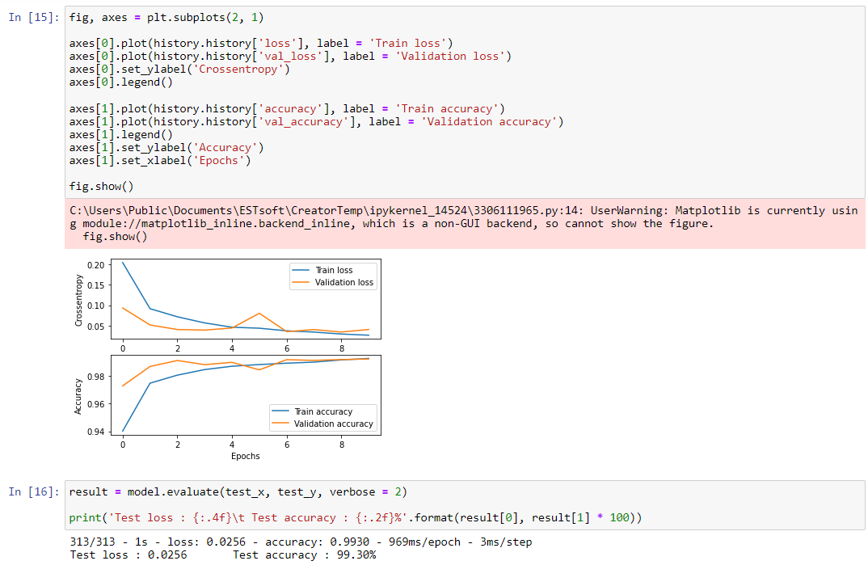
● 1. Deep CNN with Tensorflow & Keras

Slide 4
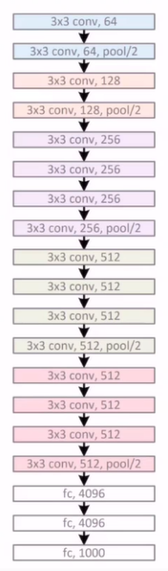
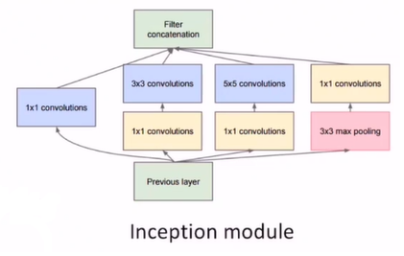
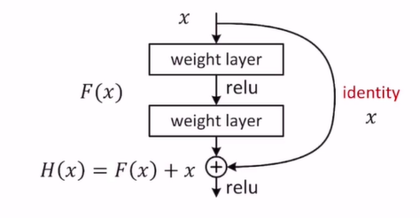
● 2. Modern CNNs
VGG16/19
GoogleNet
ResNet

